Slide 1
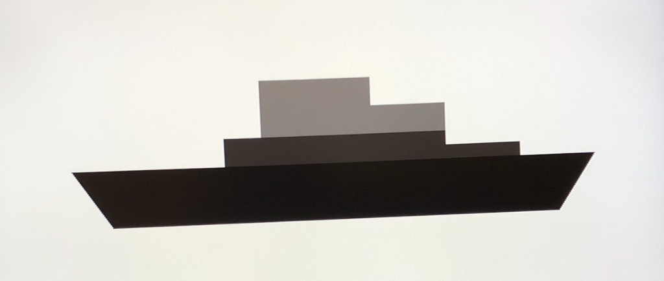
Keyboard Battleship
Jong Whee Jeon, Pratima Vaidyanathan, Daniel Gruspier, Kenneth Chan

Slide 2
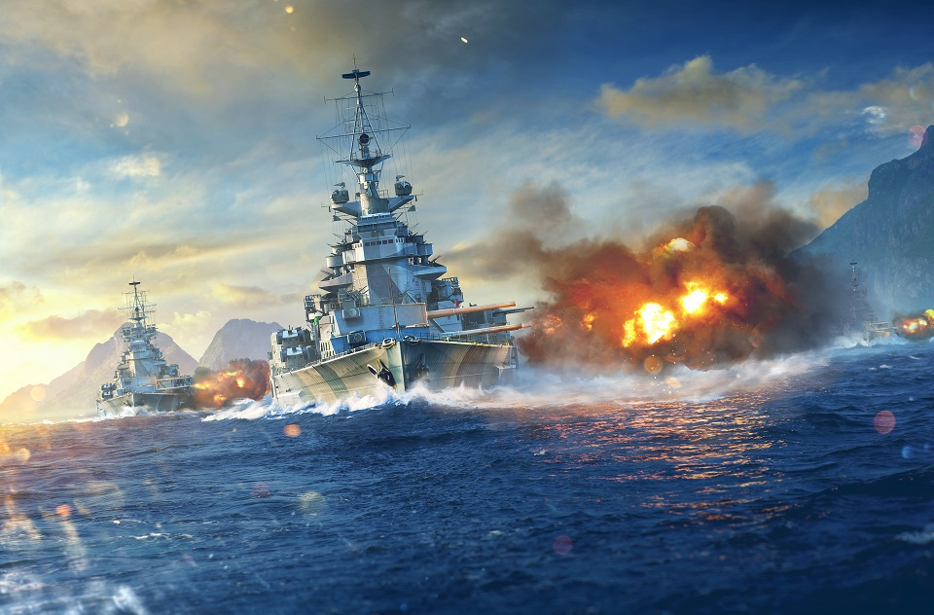
Motivation
A game that would be simple enough to code in short period
Seemed intuitive to use Keyboard as the playing field
Challenging enough to implement what we have learned in class
This is a game so people can play it in real life
Keys code module could be used for other programs that uses keyboard as input.
Module for hit and miss can be used to check off data (e.g., to-do lists, spell check, are-you-a-robot? CAPCHA)
Notes:
We wanted to make a simple game for our project. Thinking about the requirements of the project, we thought Battleship would be simple enough game to program and run it on a FPGA. Our design took the keyboard as the playing field and had the VGA output the hit and miss and win.
One way someone could use our design is to play the game?
Another way to use our design is to take the keys code. It is a code that would take the input from a keyboard and make individual input into a 1 bit data.
Parking meter capcha and the mailbox

Slide 3
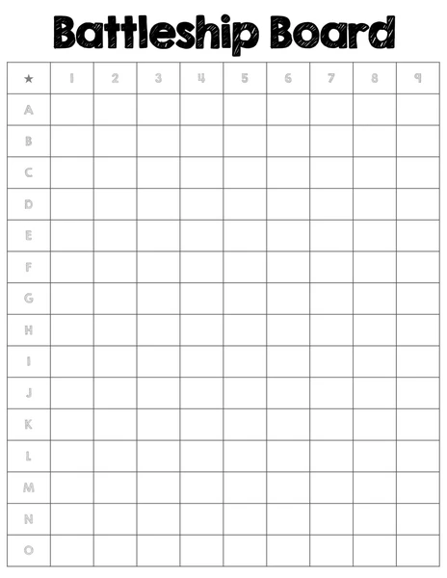
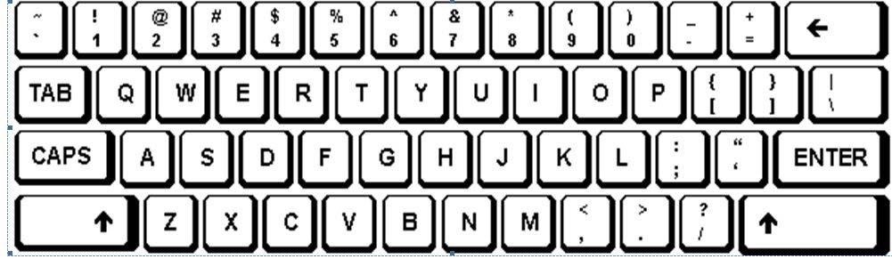
Intended Functionality

Slide 4
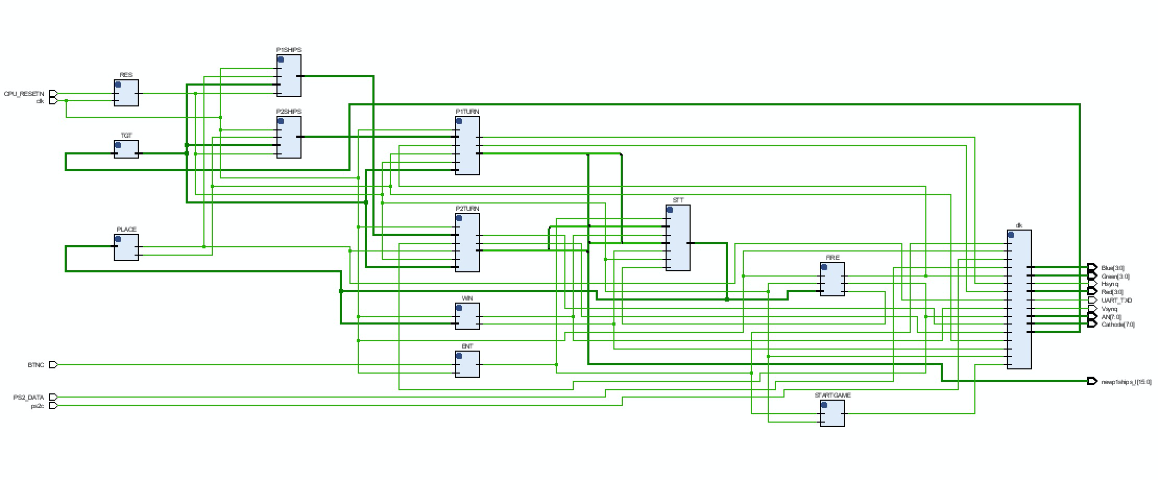

Slide 5
Intended Functionality
Begin on start screen on FPGA startup
Choose ships by typing keys and pressing Enter
Limit # of ship locations
“Fire” by choosing a key and pressing Enter
Inform players whether they hit or missed
Cannot “hit” same ship location twice
Display to players where they have already fired
Display a “win” screen

Slide 6
Specifications
Start
P1 Boats
P2 Boats
Bitmap to represent locations
Let players set their own ships
Taking turns between 2 players
Displaying whose turn it is
Showing hits and misses
Displaying the winner
P1 Fires
P1’s Turn
P2’s Turn
P2 Fires
P1 Wins
P2 Wins

Slide 7
Block Diagram
“Whose turn is it?” Logic
Player 1 Fires
(P1’s turn)
keyboard decoder
---> 1-hot bit code
Set ship locations
keyboard
Player 2 Fires
(P2’s turn)
clock
VGA Driver
reset
VGA
7-segment driver
7-segment

Slide 8
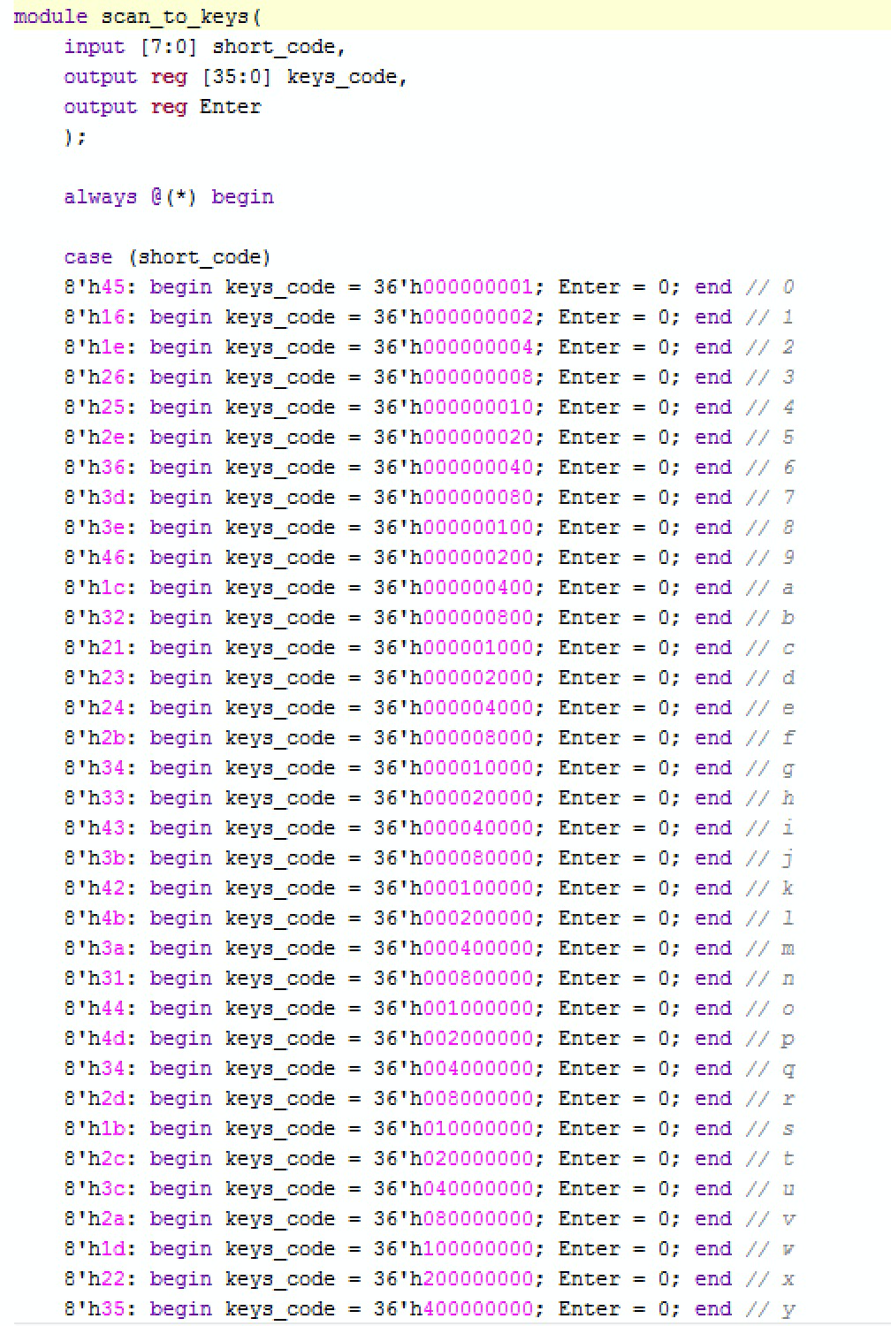
Keyboard Decoder
PS2Receiver module: creates short_code
short_code originates from 11-bit PS/2D
8-bits represented the keys pressed
short_code one-bit encoded to 36 bit keys_code
A: 00000000000000001
B: 00000000000000010
C: 00000000000000100
Each 1 represented a location
Notes:
Pratima, Kenneth
The PS2Receiver module outputs a 32 bit scan code that corresponds to every key on a keyboard. Since our game only uses 36 keys (10 numbers and 26 letters), we could simplify the output a little bit. For the keys we used in the game, the last 8 bits of the scan codes are unique to each button press, so we wrote a module that would convert an 8 bit scan code to a 36 bit one-hot encoding for every key on our battleship board. Every bit of this 36 bit bus corresponded to a unique keyboard key, so this output was easily readable and used by the game logic.

Slide 9
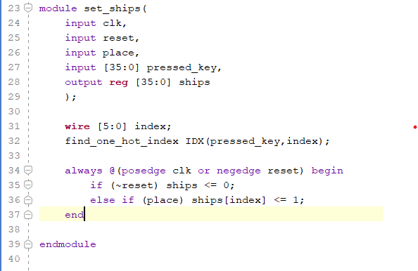
Keys_code:
Changes keys into one-hot
A => 000001
B=> 000010
AB => 000011

Slide 10
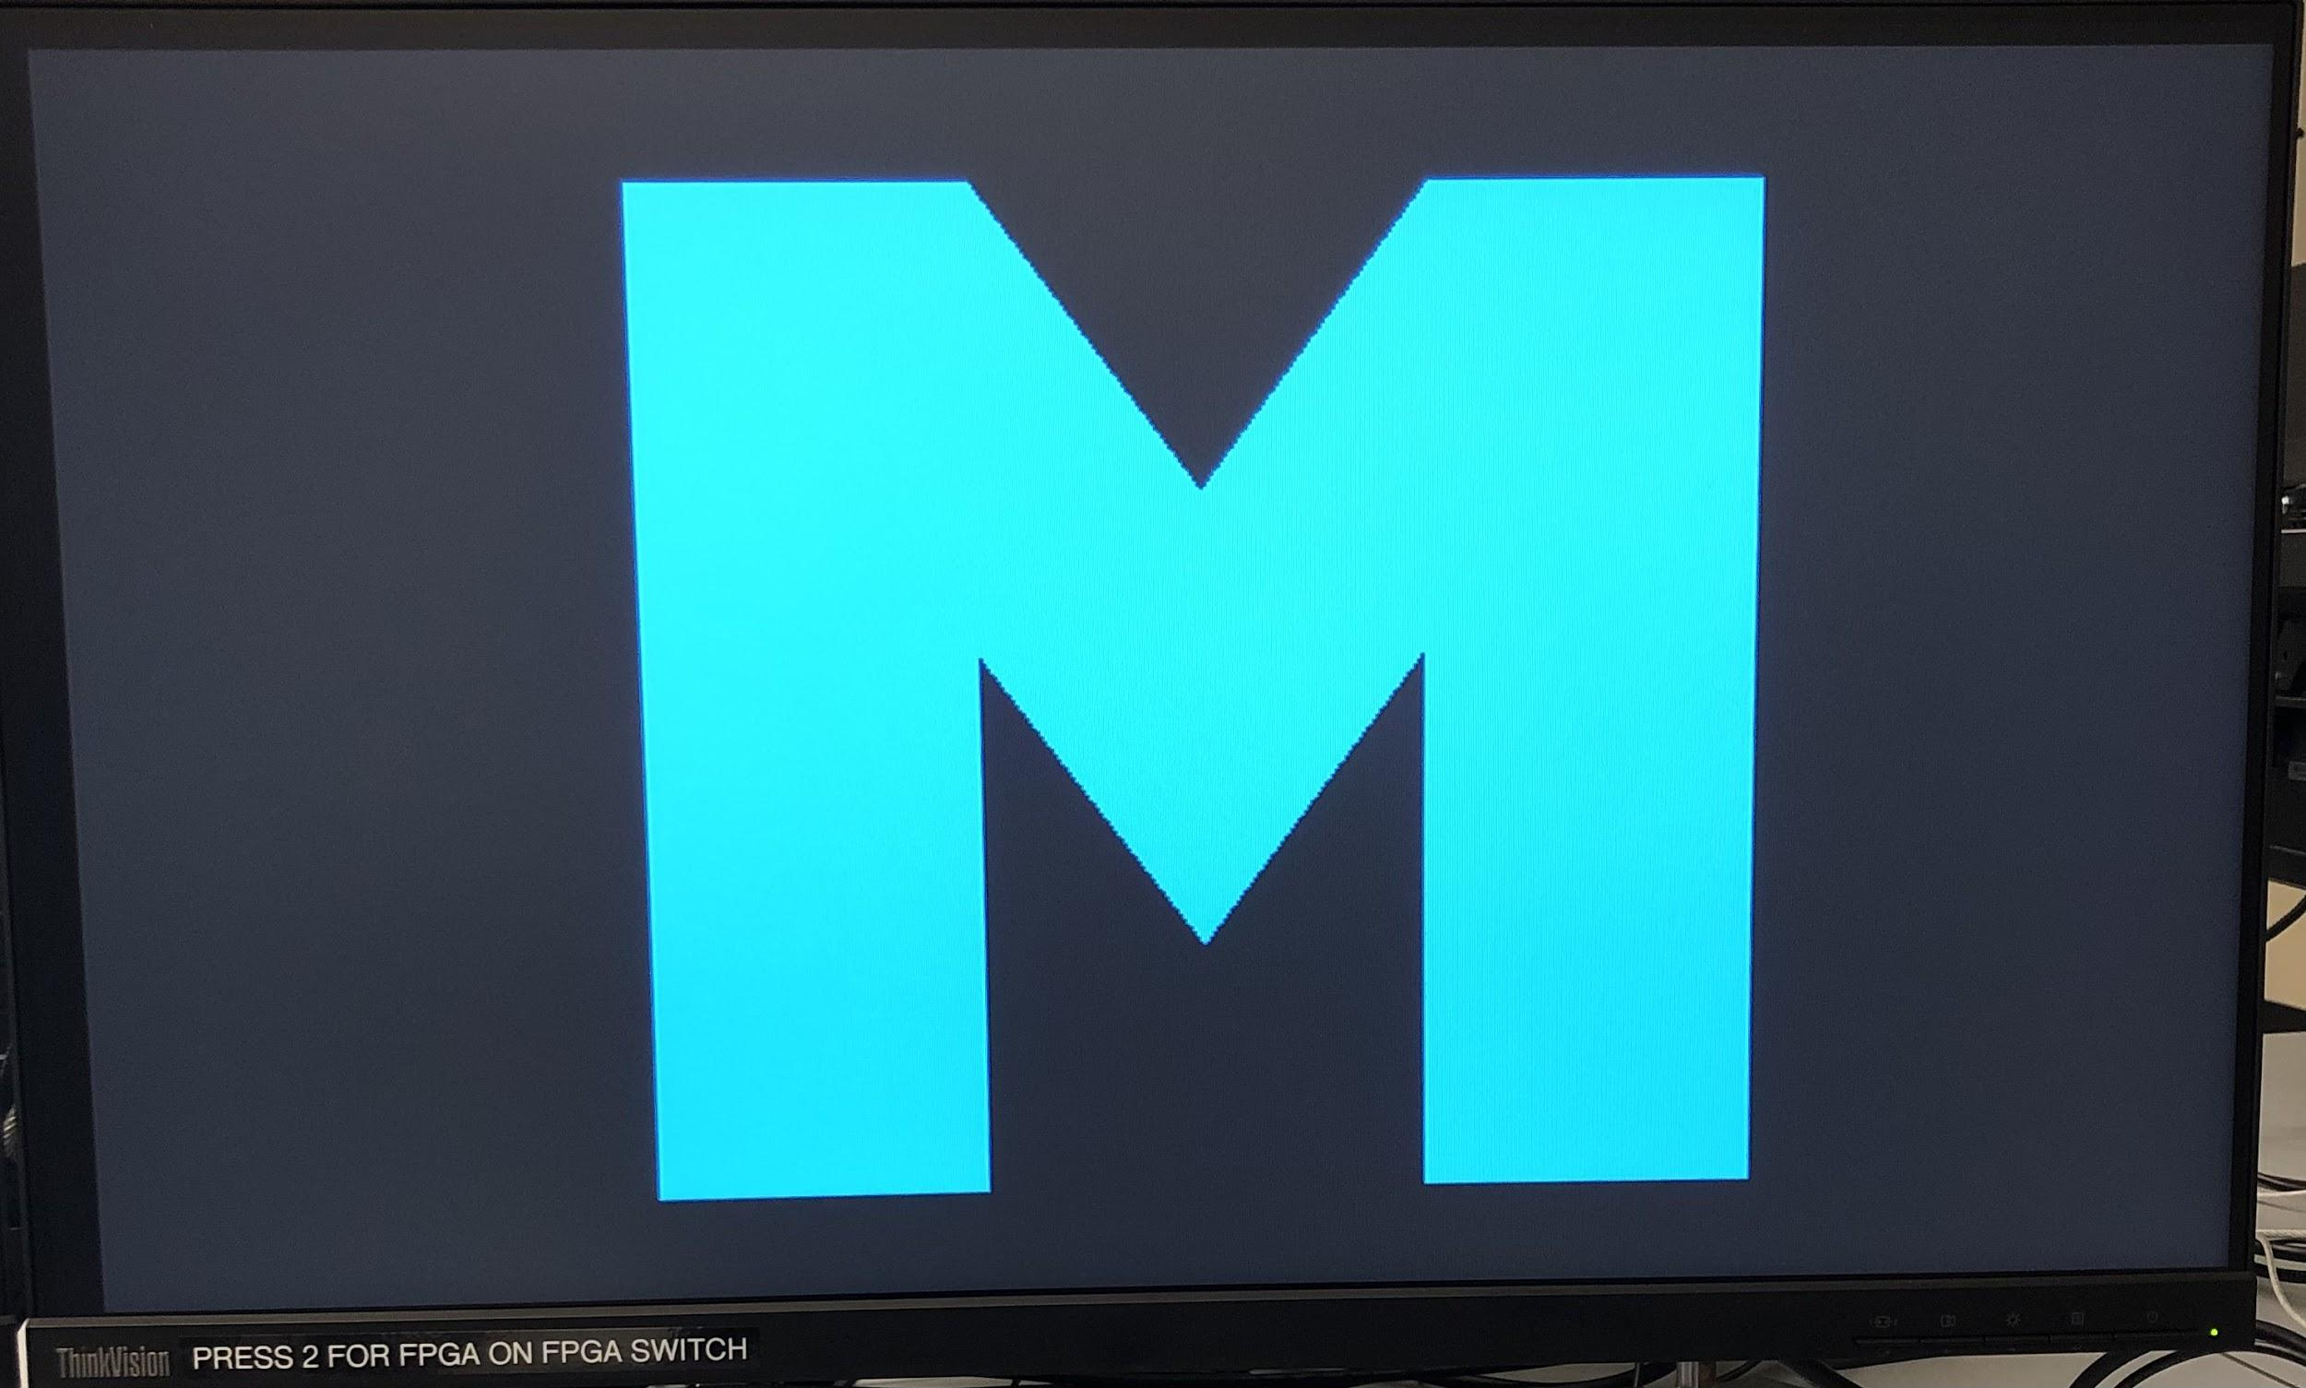
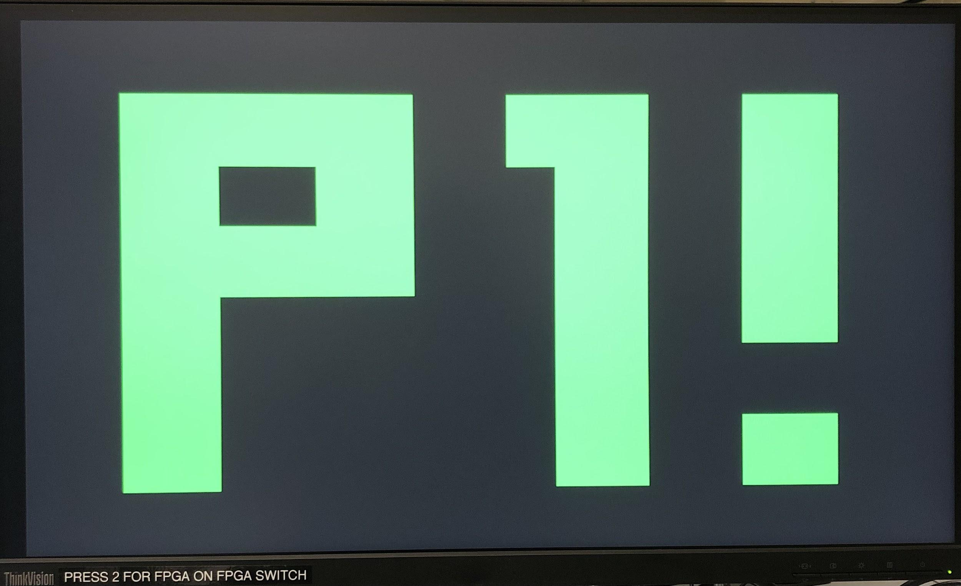
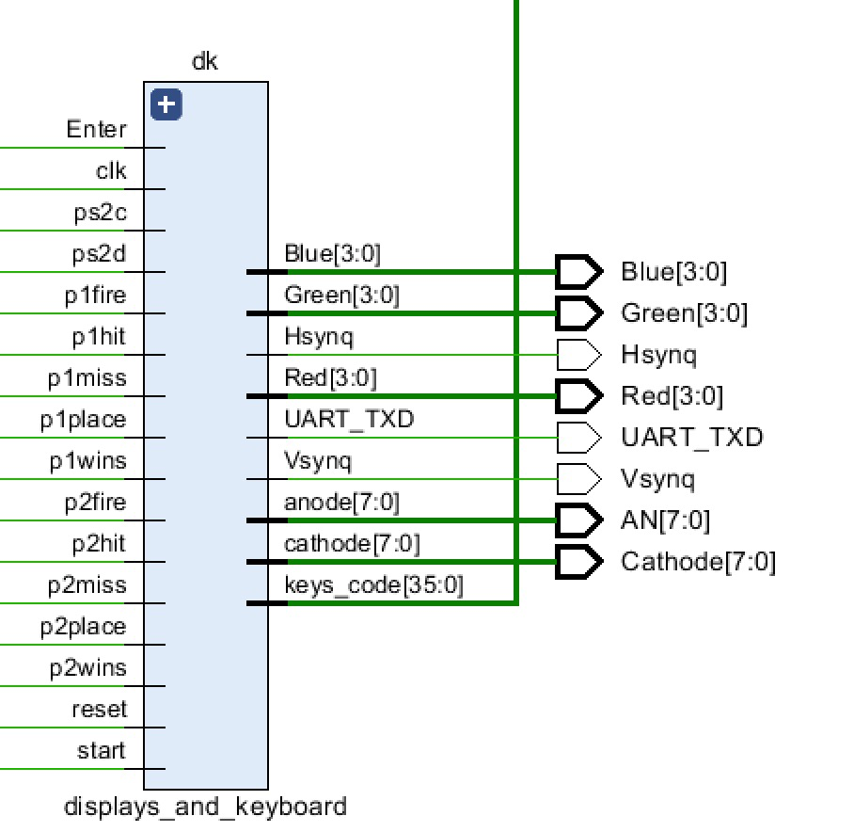
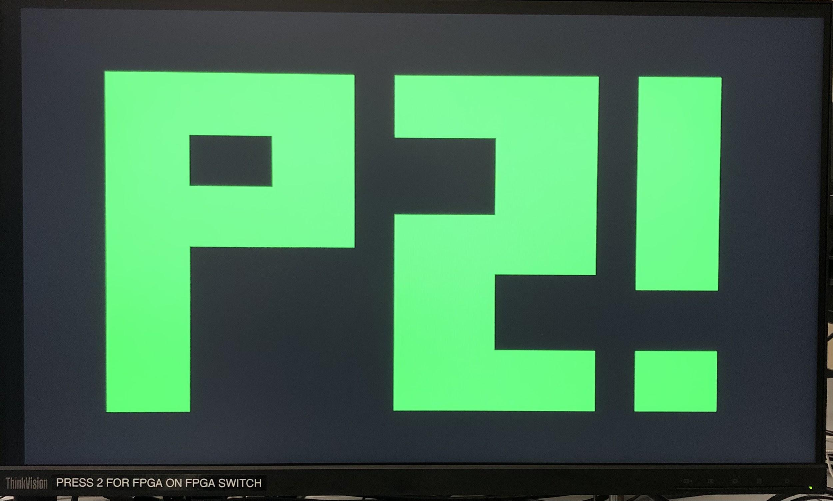
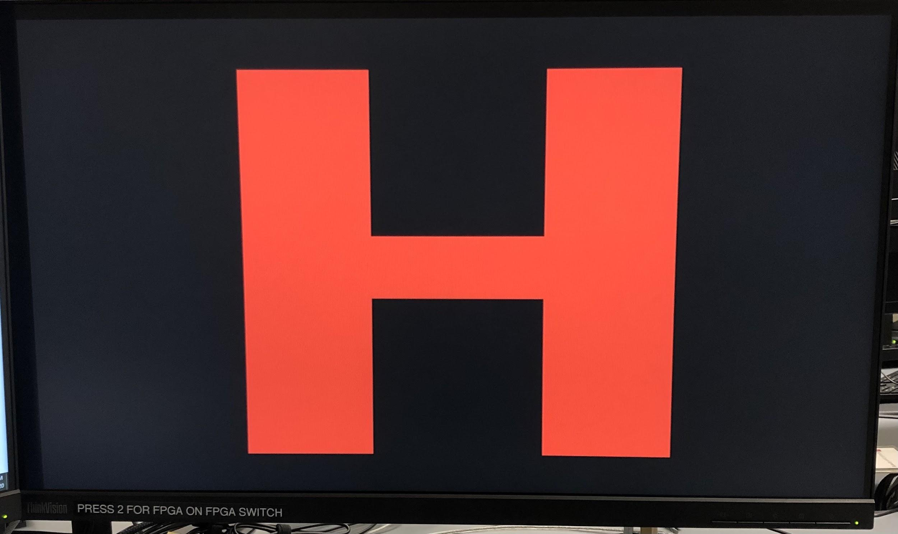
Display module inputs/outputs
Several inputs determine the seven segment display/VGA outputs
Notes:
The game logic has several outputs that are used by the display modules. P1place and p2place correspond to when players are placing ships. At this time, the seven segment display shows P1PLACE and P2PLACE so the user knows it is their turn. There are two outputs p1fire and p2fire that correspond to player turn.

Slide 11
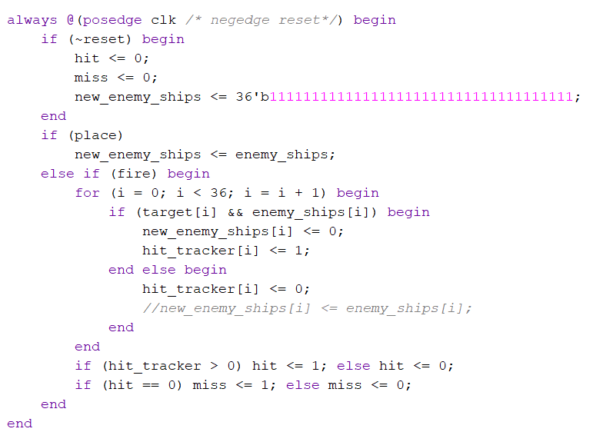
Code Snippet: hit_or_miss.v
When this register is all 0s,
that means every ship location has been hit, and therefore the game is over.
Notes:
Creates a copy of the ship locations
Evaluate whether the target key lands on a ship in the ship map
If so, give hit tracker a non zero value
Any nonzero value on the hit tracker indicates a hit
Assign the copy of the ship map a zero at that location
When this copy becomes 0, it’s a win

Slide 12
Failures
Non-linear design
Pressed keys are held into the next person’s turn
The program allows players to hit multiple keys in one turn
Resorted to a button for enter
Notes:
Problems: Pressed keys are held into the next person’s turn
Example: if the game is played as intended where players set ships and then press enter right after, the following problems occur:
One random ship is assigned to P1 based on the last key pressed in the last game
The first ship assigned to P2 is the last key pressed by P1
Pressing enter (on keyboard) in between place ship modes might zero out the keys_code output (and target_key doesn’t work for some reason) and might solve this problem, but there are other issues:
The program doesn’t account for a user pressing and hitting multiple ships in a turn. Hit or miss is determined based on the last key pressed by a player.
Scenario: One of P1’s ships is key K. On P1’s turn, he guesses that P2 has a ship on key K. P2 does not, so Miss is displayed. However, once enter is pressed and it is P2’s turn, P1’s ship K has been eliminated, because the program thinks that P2 guessed key K. Therefore, users should not guess spots on the board where their own ships are but that kinda fucks with the game.
Hitting enter (on keyboard) between turns solves this issue (so a player does not knock out their own ship), but then VGA will display Miss every time even if it should display Hit (because it’s based on the last key pressed). Doesn’t interfere with the other mechanics of the game.
-Non-linear design
Linear design helps debug errors
Easier to understand what is going on in the program
Easier to code

Slide 13
Successes
Made a cool start screen logo
Game takes in user input to set ships for each player via the keyboard
VGA Hit or Miss screen correctly displays at the end of each player’s turn
Seven segment display shows whose turn it is/if players are setting ships
When a player has no ships left, the VGA correctly displays the winner
Goes through all the states
Correct ships are knocked out
Places ships for the correct keys
Game works but there are some
unexpected quirks

